Slide 1
DATABASE CONNECTION USING MYSQL
-Manila
NK College

Slide 2
MYSQL SERVER
There is a free MySQL Community Edition available from the official MySQL website. You can download and install it on your local PC from: http://dev.mysql.com/downloads/

Slide 3
PYTHON CONNECTOR
In order to connect to MySQL, we first need to install a special Python connector driver. This driver will enable us to talk to the MySQL server from Python.
http://dev.mysql.com/doc/connector-python/en/index.html
When we start the .msi installer we briefly see a MessageBox showing the progress of the installation, but then it disappears.
We get no confirmation that the installation actually succeeded.

Slide 5
import mysql.connector as mysql
conn = mysql.connect(user=“root”, password=“scott”,host='127.0.0.1')
print(conn)
conn.close()

Slide 6
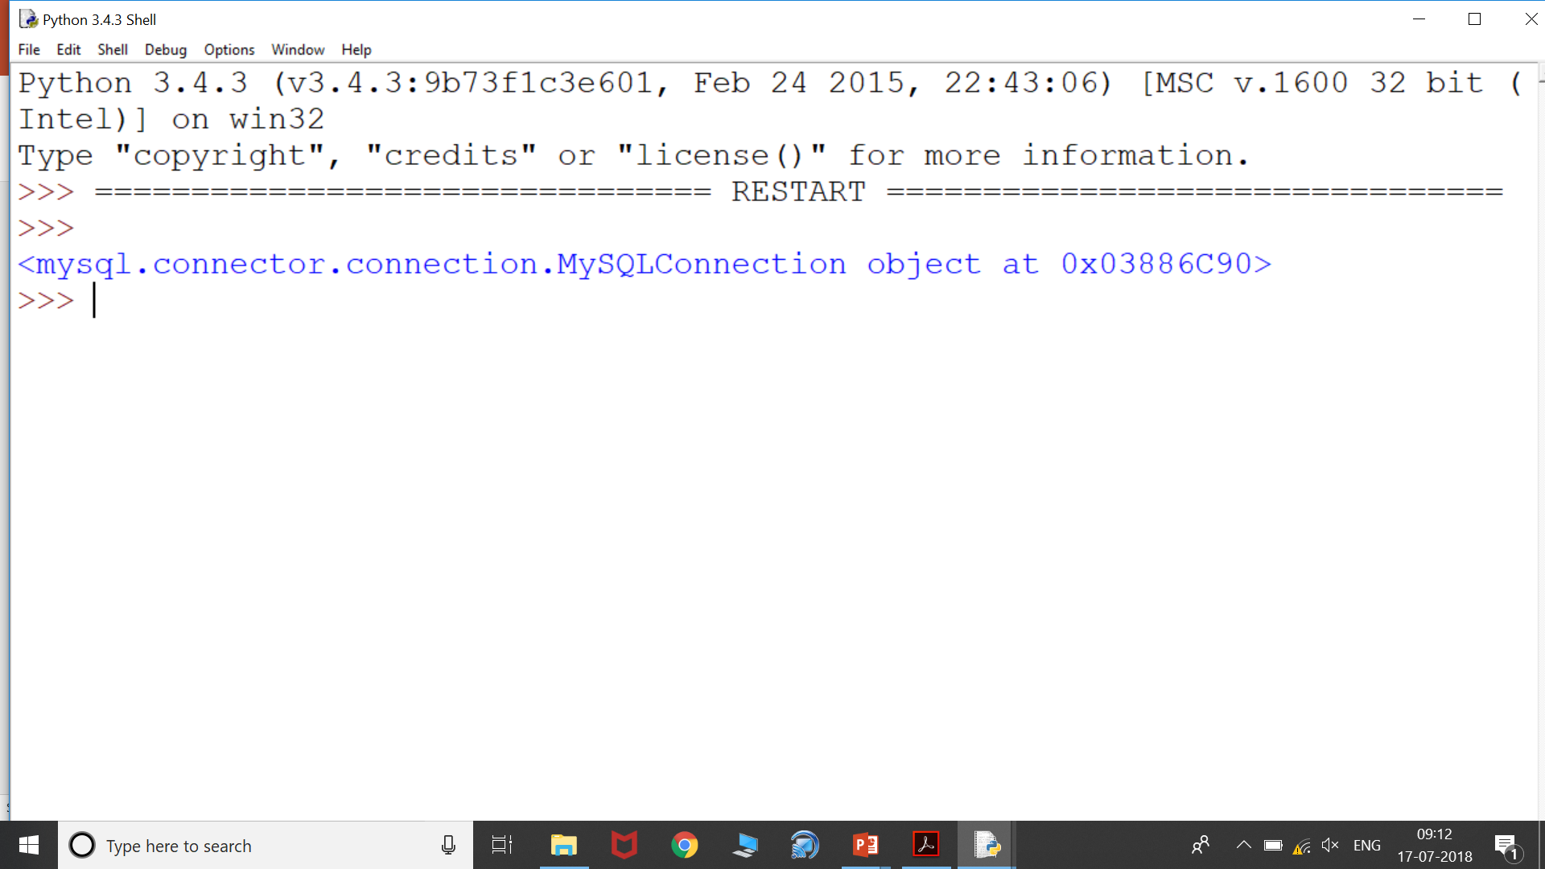

Slide 7
import mysql.connector as mysql
conn = mysql.connect(user="root", password="scott",
host='127.0.0.1')
c=conn.cursor()
c.execute("CREATE DATABASE python")
conn.close()

Slide 8
import mysql.connector as mysql
conn = mysql.connect(user="root", password="scott",
host='127.0.0.1')
c=conn.cursor()
c.execute("SHOW DATABASES")
print(c.fetchall())
conn.close()

Slide 9
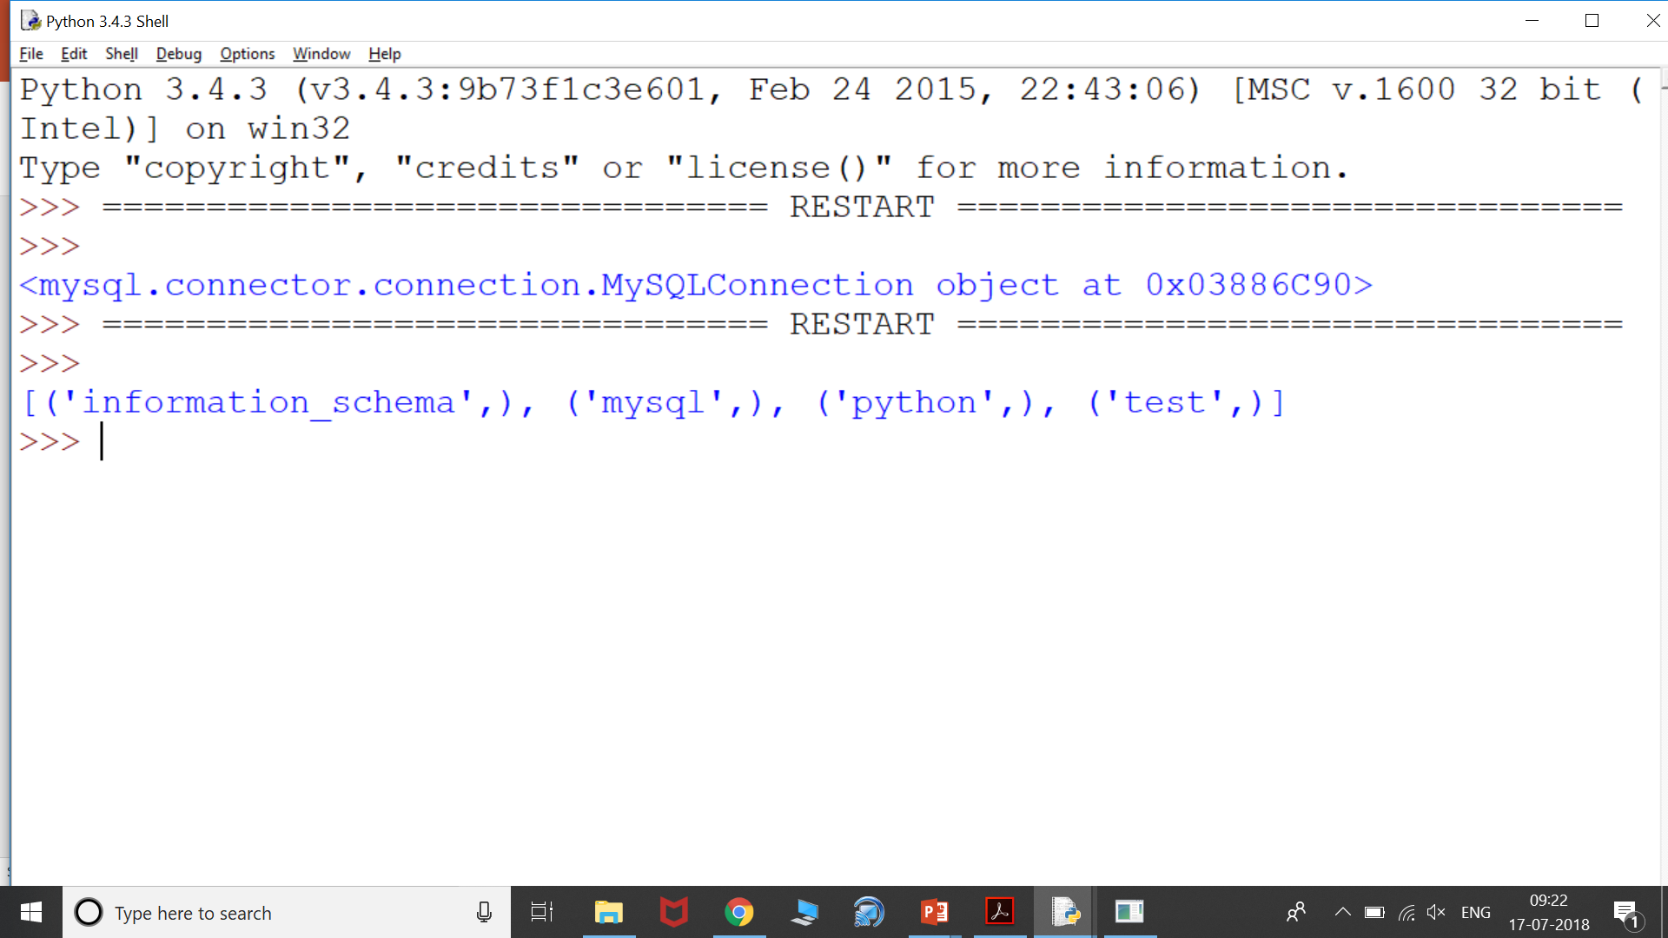

Slide 10
import mysql.connector as mysql
conn = mysql.connect(user="root", password="scott",host='127.0.0.1')
c=conn.cursor()
c.execute("SHOW DATABASES")
print(c.fetchall())
c.execute("USE python")
conn.close()

Slide 11
import mysql.connector as mysql
conn = mysql.connect(user="root", password="scott",host='127.0.0.1')
c=conn.cursor()
c.execute("show tables from python")
print(c.fetchall())
conn.close()

Slide 12
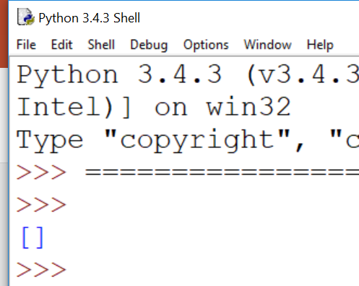

Slide 13
import mysql.connector as mysql
conn = mysql.connect(user="root", password="scott",host='127.0.0.1')
c=conn.cursor()
c.execute("USE python")
c.execute("create table employee(eno int(5),ename varchar(20))")
conn.close()

Slide 14
import mysql.connector as mysql
conn = mysql.connect(user="root", password="scott",host='127.0.0.1')
c=conn.cursor()
c.execute("show tables from python")
print(c.fetchall())
conn.close()

Slide 15
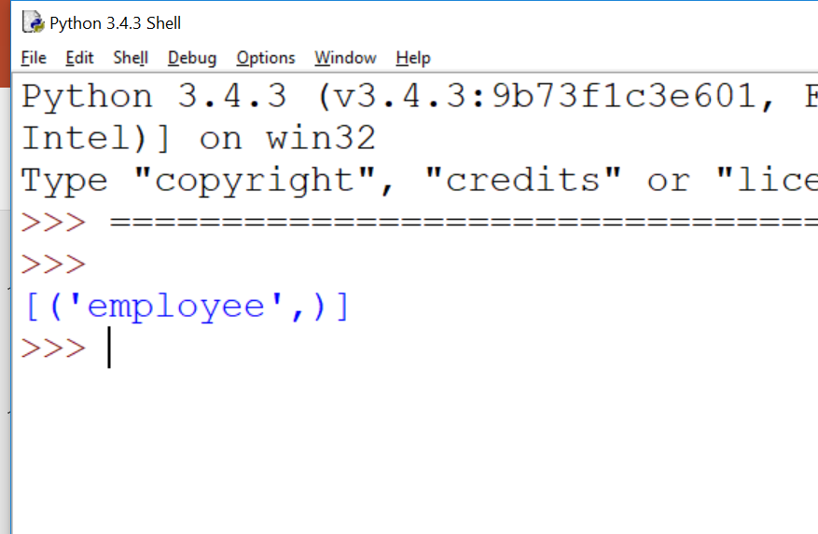

Slide 16
USING INSERT COMMAND
import mysql.connector as mysql
conn = mysql.connect(user="root", password="scott",host='127.0.0.1')
c=conn.cursor()
c.execute("use python")
c.execute("insert into employee values(1,'abc’)”)
conn.commit()
c.execute("select * from employee")
print(c.fetchall())
conn.close()

Slide 17
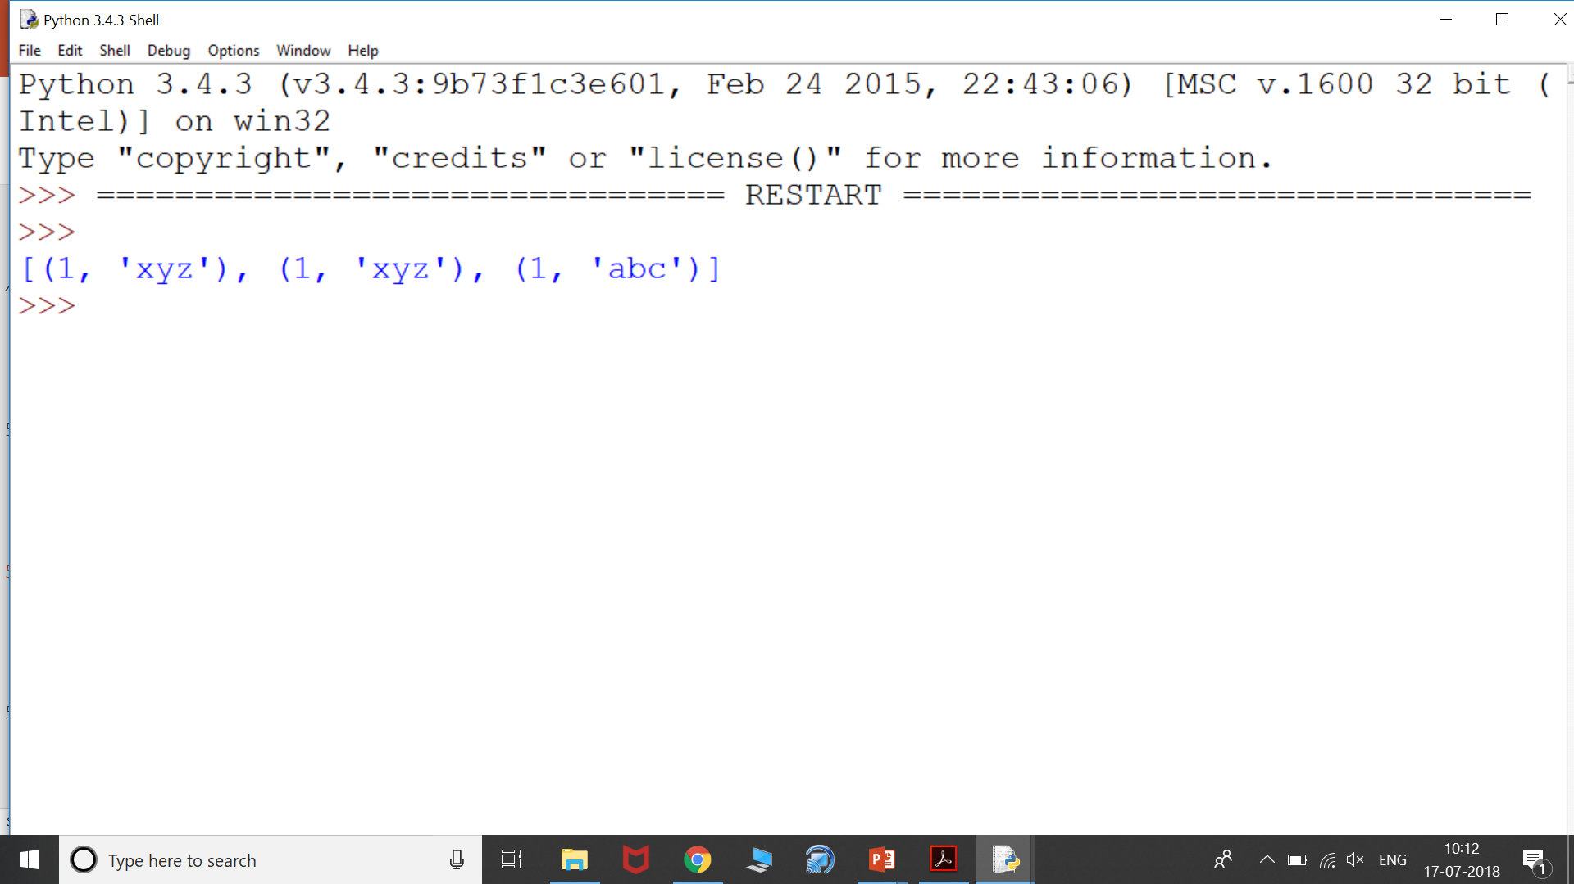

Slide 18
import mysql.connector as mysql
conn = mysql.connect(user="root", password="scott",host='127.0.0.1')
c=conn.cursor()
c.execute("use python")
c.execute("insert into employee values(2,'ghi')")
c.execute("insert into employee values(3,'def')")
conn.commit(); // need to commit the rows
c.execute("select * from employee")
print(c.fetchall())
conn.close()

Slide 19
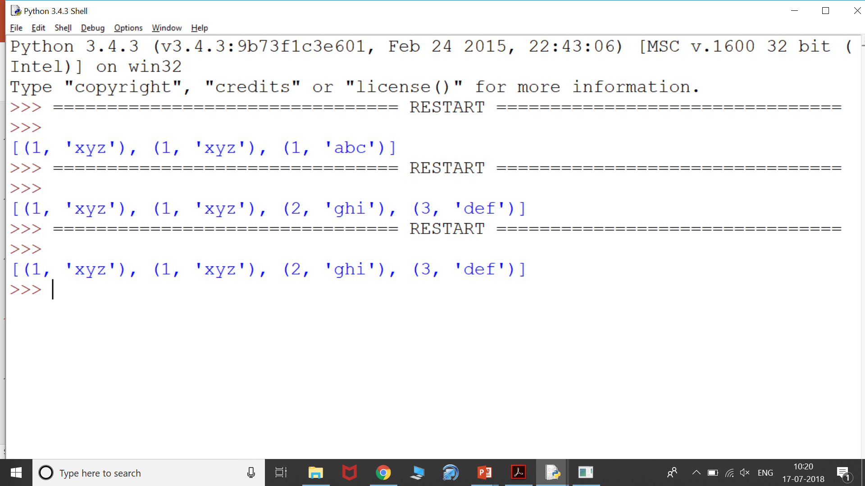

Slide 20
import mysql.connector as mysql
conn = mysql.connect(user="root", password="scott",host='127.0.0.1')
c=conn.cursor()
c.execute("use python")
c.execute("select * from employee")
rows = c.fetchall()
empid = rows[1][0]
print(empid)
c.execute("update employee set ename = 'stu' where eno = "+str(empid))
conn.commit
c.execute("select * from employee")
print(c.fetchall())
conn.close()

Slide 21
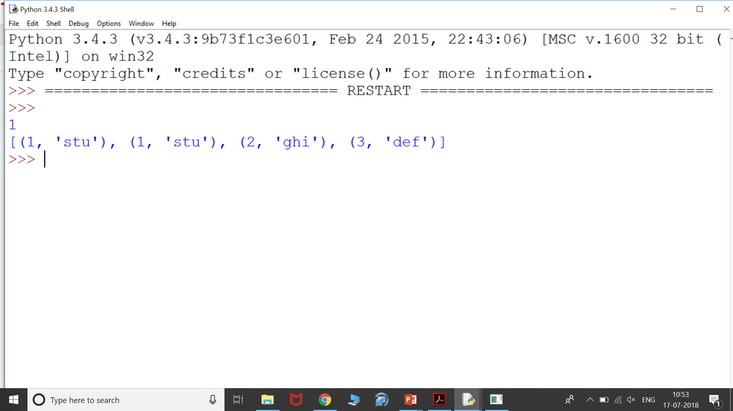

Slide 22
import mysql.connector as mysql
conn = mysql.connect(user="root", password="scott",host='127.0.0.1')
c=conn.cursor()
c.execute("use python")
c.execute("select * from employee")
rows = c.fetchall()
empname = rows[0][1]
empn = (empname,)
a= "update employee set ename = 'ghi' where ename = %s"
c.execute(a,empn)
conn.commit()
c.execute("select * from employee")
print(c.fetchall())
conn.close()

Slide 23
import mysql.connector as mysql
conn = mysql.connect(user="root", password="scott",host='127.0.0.1')
c=conn.cursor()
c.execute("use python")
c.execute("select * from employee")
rows = c.fetchall()
empid = rows[1][0]
print(empid)
c.execute("delete from employee where eno = "+str(empid))
conn.commit
c.execute("select * from employee")
print(c.fetchall())
conn.close()

Slide 24
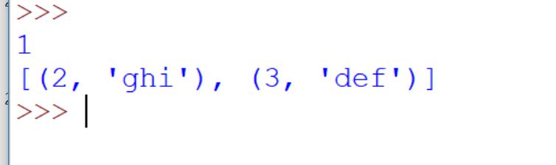

Slide 25
import mysql.connector as mysql
conn = mysql.connect(user="root", password="scott",host='127.0.0.1')
c=conn.cursor()
c.execute("use python")
c.execute("Drop table employee")
conn.close()

Slide 26
import mysql.connector as mysql
conn = mysql.connect(user="root", password="scott",host='127.0.0.1')
c=conn.cursor()
c.execute("Drop database python")
conn.close()

